Slide 1
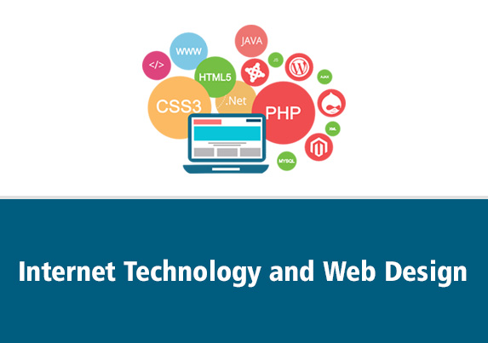
INTERNET TECNOLOGY AND WEB DESIGNING

Slide 2
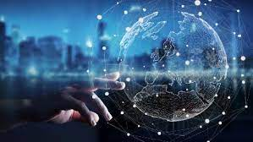
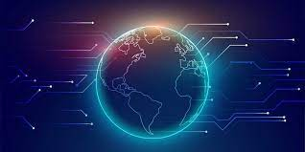
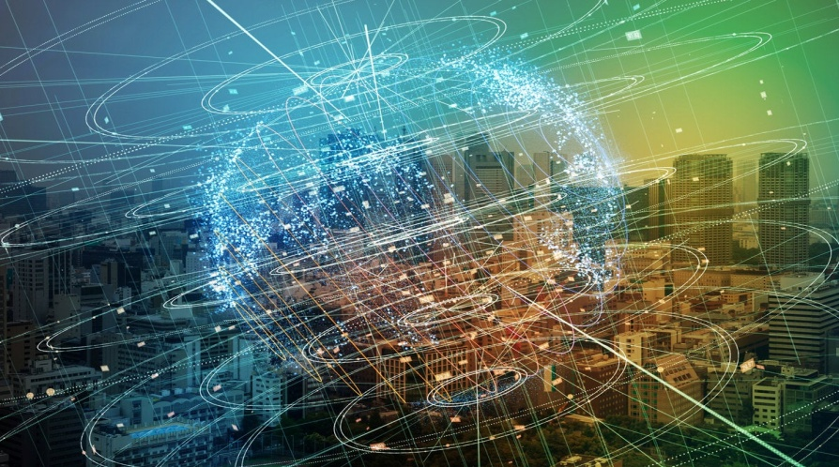
What is Internet?
Internet is the foremost important tool and the prominent resource that is being used by almost every person across the globe. It connects millions of computers, web pages, websites, and servers. Using the internet we can send emails, photos, videos, messages to our loved ones. Or in other words, the internet is a widespread interconnected network of computers and electronics devices(that support internet). It creates a communication medium to share and get information online. If your device is connected to the Internet then only you will be able to access all the applications, websites, social media apps, and many more services. Internet nowadays is considered as the fastest medium for sending and receiving information.

Slide 3
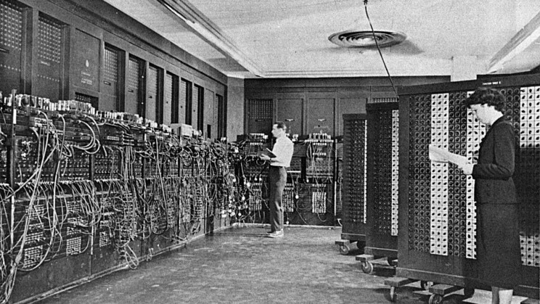
ORIGIN OF INTERNET:
The internet came in the year 1960 with the creation of the first working model called ARPANET (Advanced Research Projects Agency). It allowed multiple computers to work on a single network that was their biggest achievement at that time. ARPANET use packet switching to communicate multiple computer systems under a single network. In October 1969, using ARPANET first message was transferred from one computer to another. After that technology continues to grow.

Slide 4
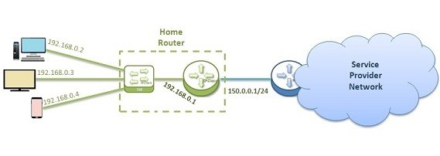
HOW IS THE INTERNET SET UP?
The internet is set up with the help of physical optical fiber data transmission cables or copper wires and various other networking mediums like LAN, WAN, MAN, etc. For accessing the Internet even the 2g, 3g, and 4g services and the wifi require these physical cable setup to access the Internet. There is an authority named ICANN (Internet Corporation for Assigned Names and Numbers) located in the USA which manages the Internet and protocols related to it like IP addresses.

Slide 5
ADVANTAGES OF THE INTERNET
1.Online Banking and Transaction: The Internet allows us to transfer money online by the net banking system. Money can be credited or Debited from one account to the other.
2.Education, online jobs, freelancing: Through the Internet, we are able to get more jobs via online platforms like LinkedIn and to reach more job providers. Freelancing on the other hand has helped the youth to earn a side income and the best part is all this can be done via INTERNET.

Slide 6
3.Entertainment: There are numerous options of entertainment online we can listen to music, play games can watch movies, web series, listening to podcasts, YouTube itself is a hub of knowledge as well as entertainment.
4.New Job roles: The Internet has given us access to social media, and digital products so we are having numerous new job opportunities like digital marketing and social media marketing online businesses are earning huge amounts of money just because the internet being the medium to help us to do so.
5.Best Communication Medium: The communication barrier has been removed from the Internet. You can send messages via email, Whatsapp , and Face book . Voice chatting and video conferencing are also available to help you to do important meetings online.

Slide 7
6.Comfort to humans: Without putting any physical effort you can do so many things like shopping online it can be anything from stationeries to clothes, books to personal items, etc. You can books train and plane tickets online.
7.GPS Tracking and Google maps: Yet another advantage of the internet is that you are able to find any road in any direction, areas with less traffic with the help of GPS in your mobile.

Slide 8
DISADVANTAGES OF THE INTERNET
1.Time wastage: Wasting too much time on the internet surfing on social media apps and doing nothing decreases your productivity rather than wasting time on scrolling social media apps one should utilize that time in doing something skillful and even more productive.
2.Bad impacts on health: Spending too much time on the internet causes bad impacts on your health physical body needs some outdoor games exercise and many more things. Looking at the screen for a longer duration causes serious impacts on the eyes.

Slide 9
3.Cyber Crimes: Cyber bullying, spam, viruses, hacking, and stealing data are some of the crimes which are on the verge these days. Your system which contains all the confidential data can be easily hacked by cybercriminals.
4.Effects on children: Small children are heavily addicted to the Internet watching movies, games all the time is not good for their overall personality as well as social development.
5.Bullying and spreading negativity: The Internet has given a free tool in the form of social media apps to all those people who always try to spread negativity with very revolting and shameful messages and try to bully each other which is wrong.

Slide 10
